Slide 1
Online Payment Fraud Detection
Sarithala Ashraff -AP25122040018
Bode Vamsi Krushna - AP25122040009

Slide 2
Introduction
Online Transactions Rising: Digital payment systems experiencing exponential growth worldwide
Fraud Threat: Heightened exposure to fraudulent activities and security risks
ML & DL Role: Machine Learning and Deep Learning enable intelligent fraud detection
Real-time Detection: Automated systems protect millions of transactions daily

Slide 3
Problem Statement
Severe Class Imbalance: 6.3 million transactions with only 0.15% fraudulent cases (8,213 instances)
Challenge: Models bias toward majority class, missing critical fraud patterns
Scale Issue: Processing large-scale financial datasets efficiently
Accuracy Trade-off: Balance between detecting fraud and minimizing false alarms

Slide 4
Dataset Overview
Dataset Characteristics
Key Features
Total Records: 6.3 Million
Fraudulent Cases: 8,213 (0.15%)
Features: 10 dimensions
Type: Financial transactions
Transaction Step & Amount
Sender/Receiver Balances
Engineered Features
Target: isFraud Label

Slide 5
Methodology: Data Processing
Data Cleaning: Handling missing values and removing duplicates
Feature Encoding: Categorical variables (transaction type) encoded to numerical format
Normalization: Scaling features to consistent range for model training
Train-Test Split: 80% training, 20% testing for unbiased evaluation

Slide 6
Feature Engineering
Creating derived features to capture fraud patterns:
Engineered Features:
origin_error: Balance difference (sender)
dest_error: Balance difference (receiver)
Ratio features for anomaly detection
Total Features: 10
step, type, amount
oldBalanceOrig, newBalanceOrig
oldBalanceDest, newBalanceDest

Slide 7
Handling Class Imbalance
Challenge: Only 0.15% fraudulent transactions create severe imbalance
Solution: SMOTE (Synthetic Minority Oversampling Technique)
Generates synthetic minority samples
Balances training dataset distribution
Prevents model bias toward legitimate transactions
Enables effective fraud pattern learning

Slide 8
DNN Architecture
Model Design: Multi-layer Deep Neural Network
Input Layer: 10 features from engineered dataset
Hidden Layers: 128 → 64 → 32 neurons with ReLU activation
Regularization: Dropout layers prevent overfitting
Output Layer: Sigmoid activation for binary classification (Fraud/Legitimate)

Slide 9
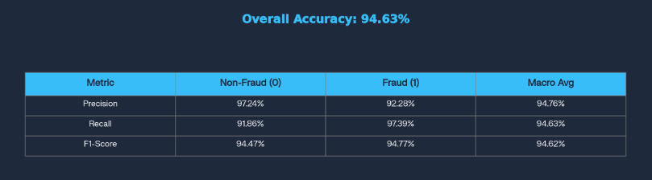
Model Evaluation Metrics
Accuracy: Overall classification correctness
Precision: True positives among predicted positives
Recall (Critical): Fraud cases detected; missing fraud = higher risk
F1-Score: Harmonic mean of precision and recall

Slide 10
How It Works: Real-Time Detection
1. Transaction Input
→
2. Feature Engineering
→
3. DNN Prediction
↓
4. Fraud/Legitimate Decision

Slide 11
Website Interface

Slide 12
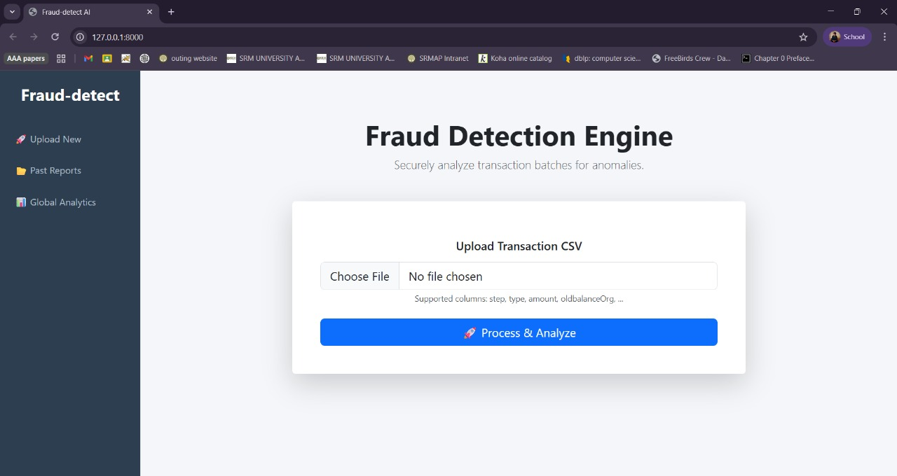

Slide 13
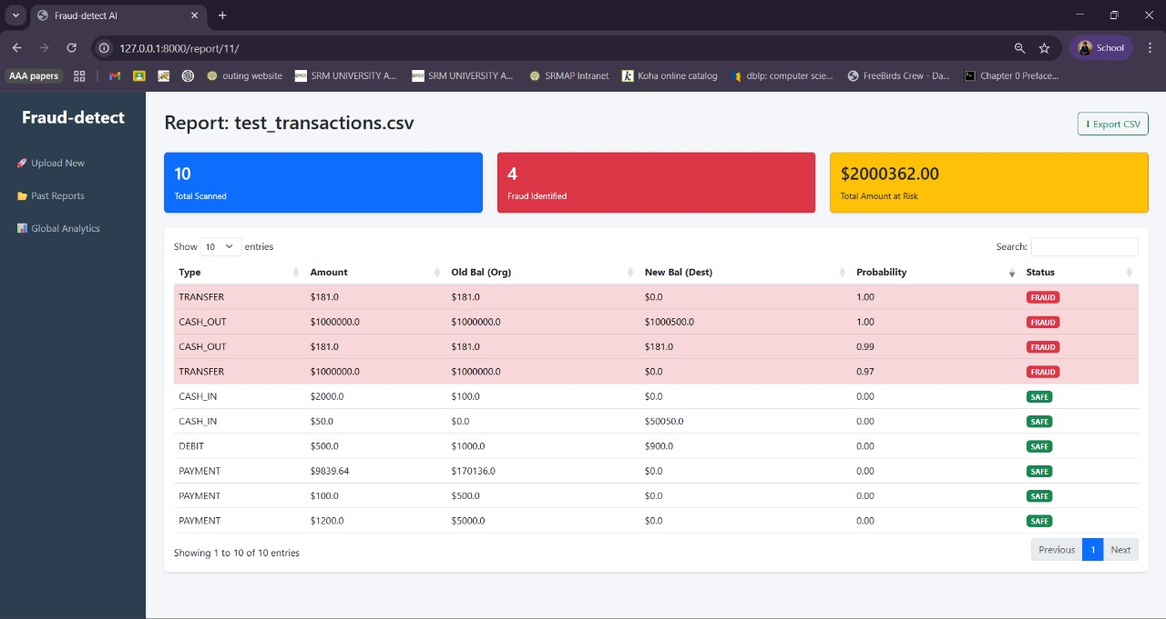

Slide 14
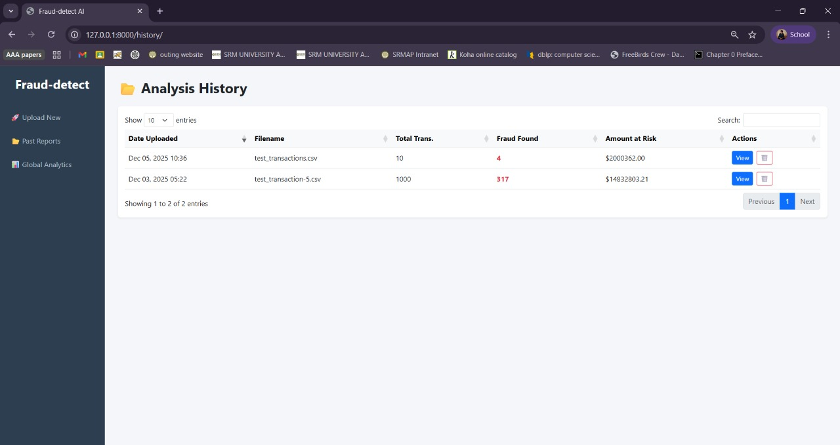

Slide 15
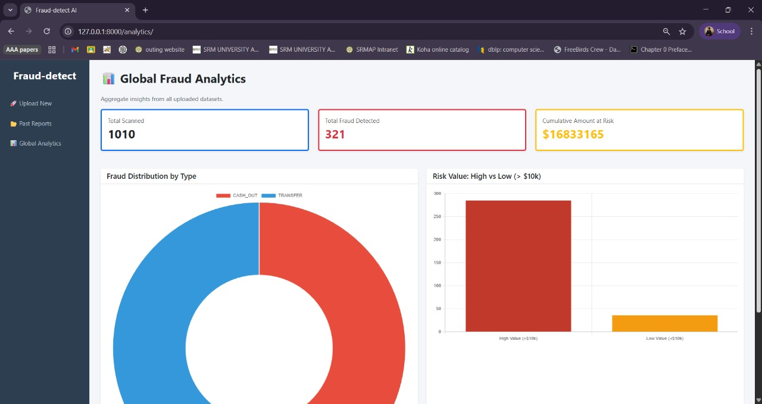

Slide 16
Challenges
Severe Class Imbalance: Fraud represents only 0.15% of data
Large Scale Processing: Handling 6.3 million records efficiently
Feature Complexity: Understanding relationships between financial attributes
False Positives: Balancing fraud detection with user experience

Slide 17
Future Scope & Enhancements
Advanced Architectures: LSTM, GRU for temporal fraud patterns
Ensemble Methods: Combining multiple models for robustness
Real-time Adaptation: Online learning for evolving fraud tactics
Explainability (XAI): Understanding model decisions for transparency

Slide 18
Key Contributions
Technical
Practical
SMOTE for imbalance handling
Feature engineering pipeline
Optimized DNN architecture
Production-ready system
Scalable implementation
Real-time detection capability

Slide 19
Conclusion
This project successfully demonstrates a Deep Neural Network-based fraud detection system capable of processing large-scale financial datasets with severe class imbalance. Through effective data preprocessing, feature engineering, and SMOTE-based balancing, the model achieves strong performance in detecting fraudulent transactions while maintaining system scalability and reliability for real-world deployment.

Slide 20
Thank You!
Questions & Discussion

